Slide 1


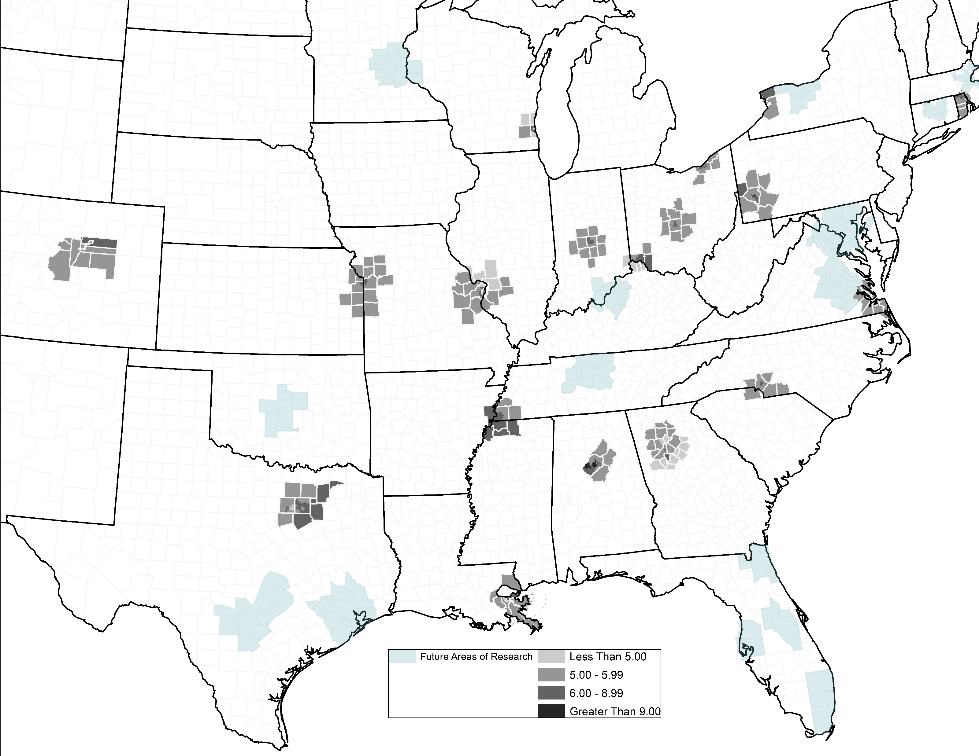
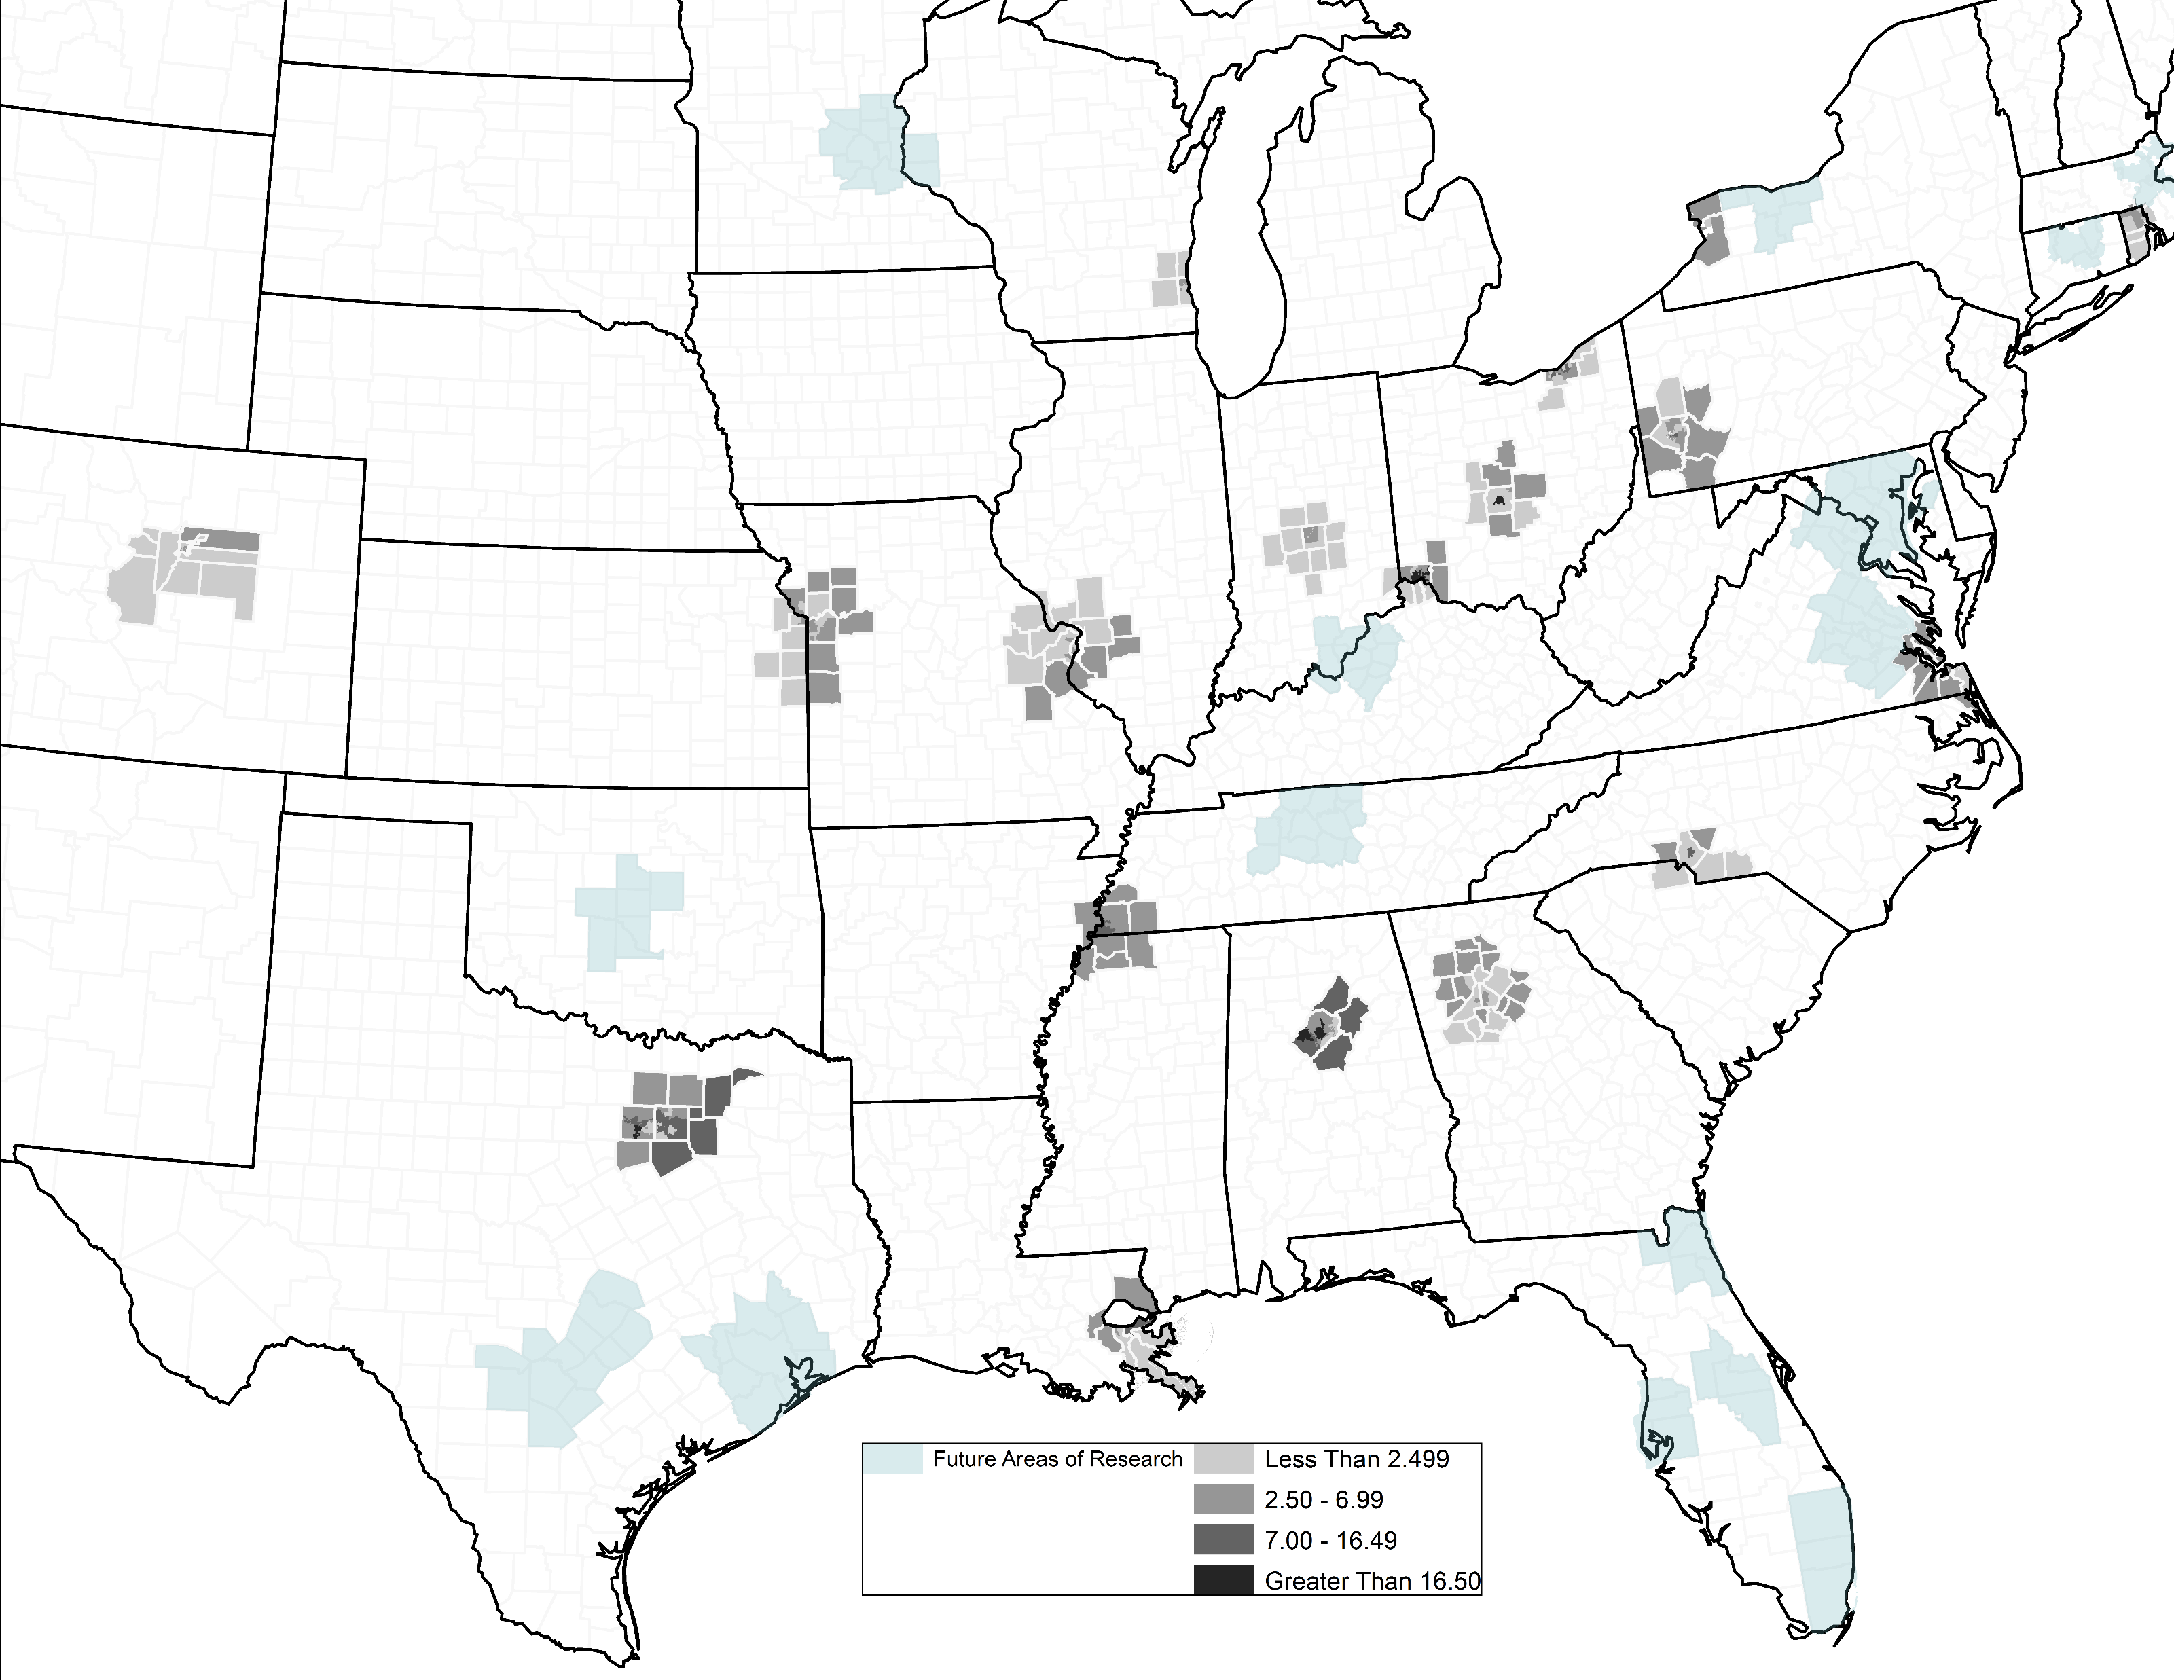
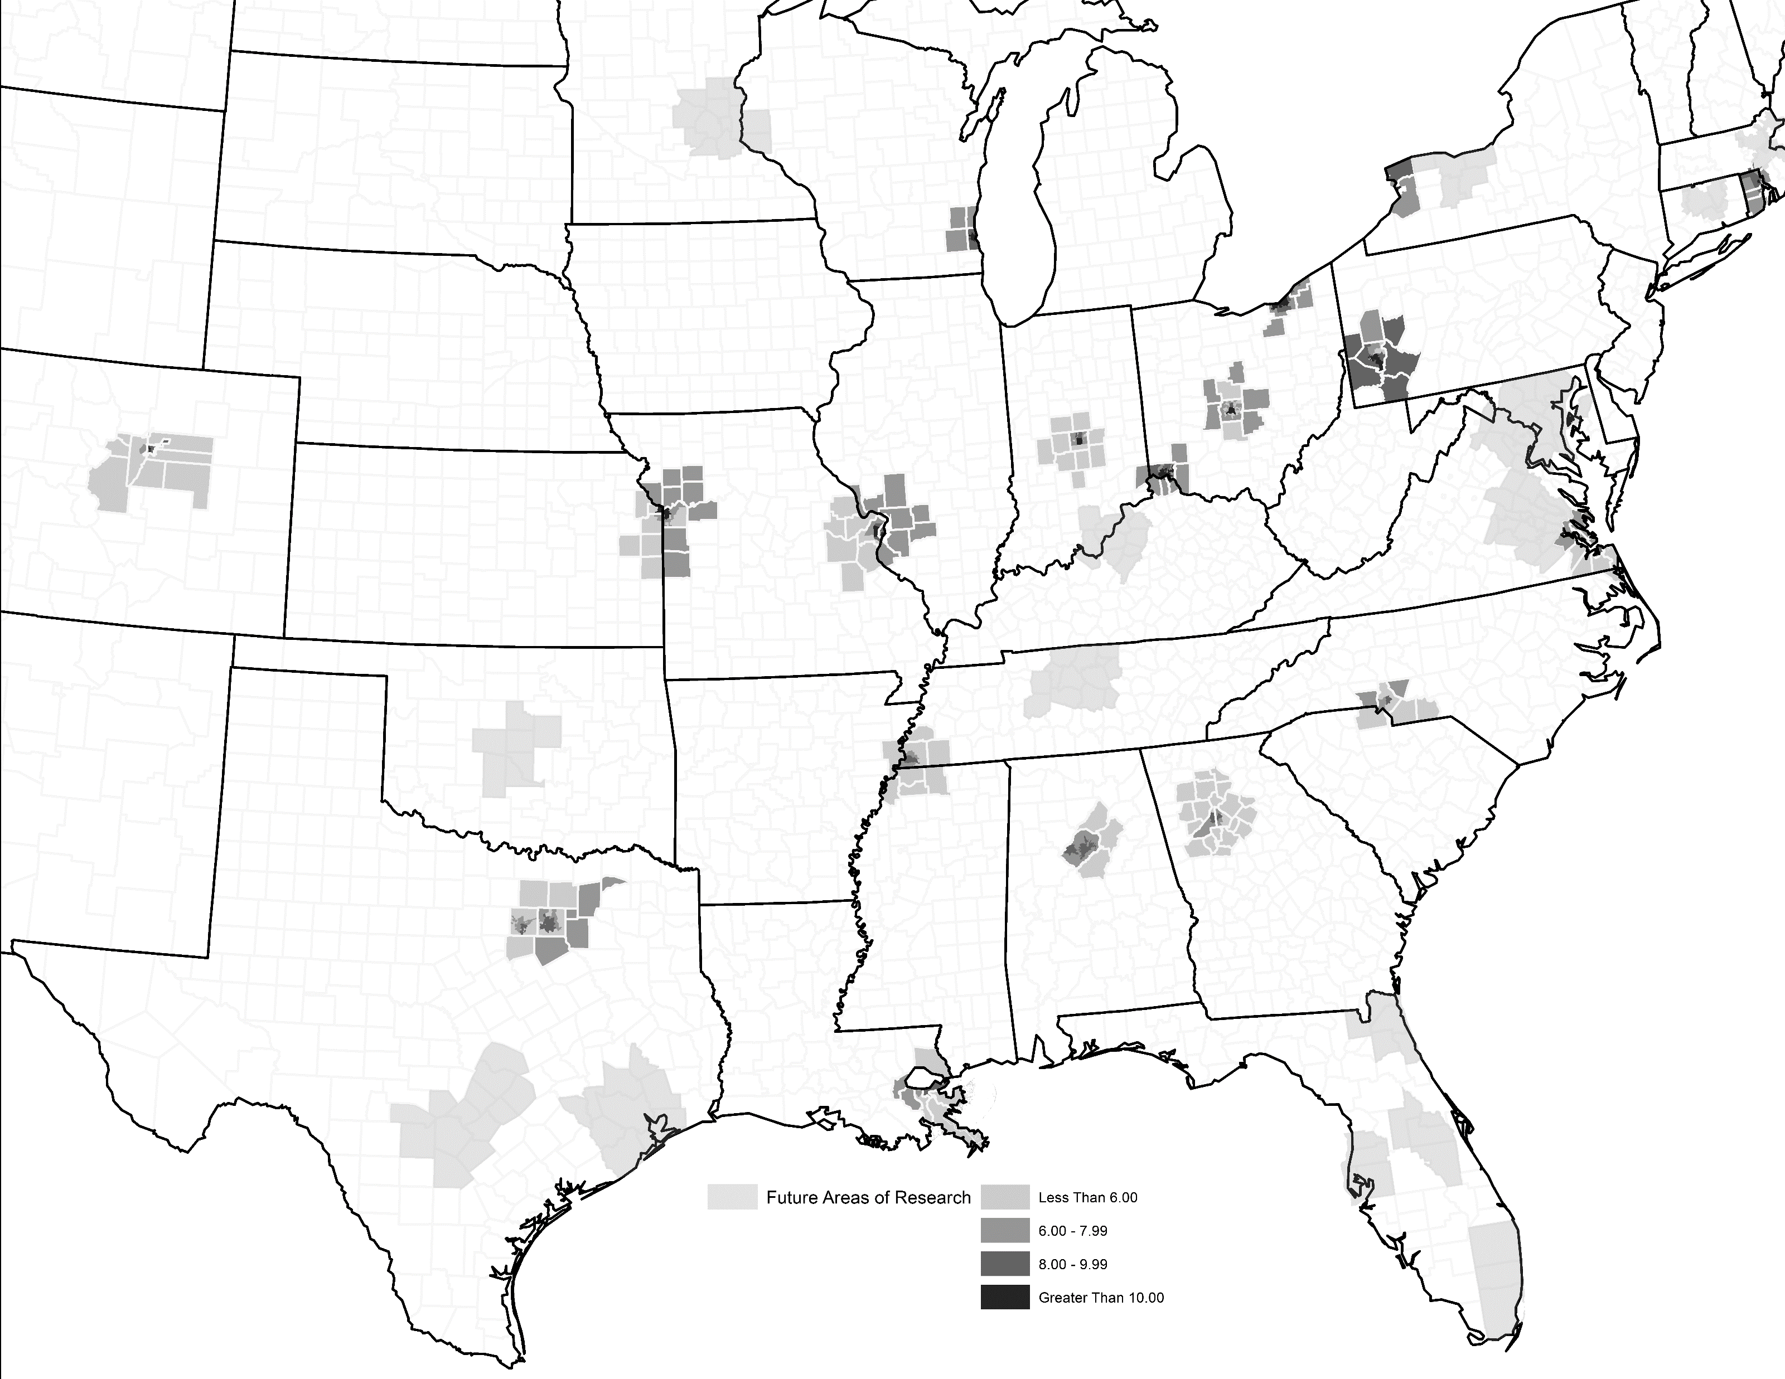


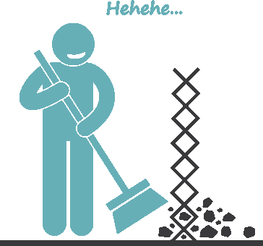
KEEPING UP WITH THE JONESES:
MEASURING INDIVIDUAL HOMEOWNER MAINTENANCE BEHAVIOR USING NEIGHBOR INFORMATION
JOEY CAMPBELL, PHD, MATTHEW J MARTINEZ, PHD
OVERVIEW
RESULTS
It is widely accepted that proper maintenance is essential in owning a home as the lack of maintenance will ultimately cost property owners more due to higher costs associated with repairs, renovations, or replacements (Van Zandt et al, 2011). However, little empirical evidence exists in the extant literature examining this relationship. Therefore, the purpose of this research is to develop a measure of maintenance behavior in line with recent work by the U.S. Department of Housing and Urban Development (Frederick J. Eggers and Fouad Moumen, 2013).
First, we operationalize maintenance behavior using aggregate level data and then test how well this construction performs in predicting individual property claims. We argue that using aggregate level maintenance data as a proxy for individual maintenance behavior has multiple benefits. Foremost, the ease of access to aggregate level data make analyses more accessible especially when compared to the enormously high cost of collecting individual data. Second, given the contagion effect that exists when individuals are surrounded by other poor-/well- maintained properties, we can easily derive potential individual property risk by analyzing aggregate data.
Table 2 displays results of this analysis. We find that our maintenance index follows the hypothesized relationship with water loss as individuals in living in zones with higher scores have a higher likelihood to have a claim. Conversely, both the PQI and housing adequacy measures have the opposite relationship with water loss than was hypothesized. The findings indicate that individuals living in neighborhoods with more poor quality/adequate housing are less likely to file a claim. The results require further investigation including adding additional metropolitan areas (seen in teal on the maps) and measuring neighborhood characteristics at a more finite scale (namely Census tracts).
MAPPING
THE
INDEX
POOR QUALITY INDEX
HOUSING ADEQUACY
NEIGHBORHOOD MAINTENANCE
TABLE 2: ODDS RATIOS FOR H2O LOSS MODEL
METHODS
Variable |  | Original Model |  |  | Poor Quality Index (PQI) |  |  | Housing Quality (ZADEQ) |  |  | Maintenance Index
(Intercept) |  | -3.233 | *** |  | -2.988 | *** |  | -3.217 | *** |  | -3.275 | ***
Age of Home (Ref= less than 5 years)
5 - 9 |  | 0.508 | *** |  | 0.507 | *** |  | 0.508 | *** |  | 0.509 | ***
10 - 14 |  | 0.720 | *** |  | 0.717 | *** |  | 0.719 | *** |  | 0.721 | ***
15 - 29 |  | 0.827 | *** |  | 0.823 | *** |  | 0.825 | *** |  | 0.827 | ***
30 - 49 |  | 0.734 | *** |  | 0.731 | *** |  | 0.732 | *** |  | 0.730 | ***
50 - 54 |  | 0.606 | *** |  | 0.606 | *** |  | 0.605 | *** |  | 0.596 | ***
55 - 59 |  | 0.463 | *** |  | 0.464 | *** |  | 0.461 | *** |  | 0.449 | ***
60 - 64 |  | 0.442 | *** |  | 0.445 | *** |  | 0.441 | *** |  | 0.425 | ***
65 plus |  | 0.389 | *** |  | 0.398 | *** |  | 0.391 | *** |  | 0.366 | ***
Geography |  | 0.371 | *** |  | 0.356 | *** |  | 0.369 | *** |  | 0.375 | ***
Amount of Insurance Deductible |  | -0.494 | *** |  | -0.493 | *** |  | -0.493 | *** |  | -0.494 | ***
Size of Household |  | 0.057 | *** |  | 0.057 | *** |  | 0.057 | *** |  | 0.057 | ***
Home Size |  | 0.209 | *** |  | 0.209 | *** |  | 0.209 | *** |  | 0.210 | ***
Historical Water Losses |  | 0.475 | *** |  | 0.472 | *** |  | 0.474 | *** |  | 0.474 | ***
Historical Losses |  | 0.185 | *** |  | 0.187 | *** |  | 0.186 | *** |  | 0.186 | ***
Payment Cancellations |  | 0.205 | *** |  | 0.205 | *** |  | 0.205 | *** |  | 0.205 | ***
PQI |  | -- |  |  | -0.044 | *** |  | -- |  |  | --
ZADEQ |  | -- |  |  | -- |  |  | -0.481 | ** |  | --
Maintenance Index |  | -- |  |  | -- |  |  | -- |  |  | 0.007 | **
AIC (smaller is better) |  | 438864 |  |  | 438841 |  |  | 438858 |  |  | 438859
* p < 0.05; ** p < 0.01; *** p<0.001
We use a unique dataset combining proprietary data from a large national insurer with neighborhood data from the United States Census Bureau’s 2011 American Housing Survey (AHS). The AHS includes information on physical characteristics of the structure, property condition, upgrade and remodeling activities, and neighborhood quality. The U.S. Department of Housing and Urban Development has recently produced a measure of neighborhood quality with the Poor Quality Index (PQI). PQI is an improvement on the concept of housing adequacy (ZADEQ) as it focuses more on holistic deficiencies in the home. In addition to these two measures of housing quality we introduce a separate index of neighborhood maintenance which includes a few variables from the PQI and housing adequacy indices. We use a factor analytic technique (Krishnan (2010) to derive the items for our neighborhood maintenance measure.
We empirically link all indices to individual risk water claims and compare the results to understand how each performs in assessing future risk. Each index is summarized at the Zone level of geography which is provided by the public-use version of the 2011 AHS. Following the logic of Ioannides (2002) and Helms (2012), individuals who live in neighborhoods that have poor quality/maintenance should be at higher risk of loss compared to individuals in better maintained neighborhoods.
Table 1 - Variables and their Factor Loadings in Maintenance Index
Variable Description | Variable in AHS | Score (Weight)
Age of Home | BUILT | 0.147
Fuses blown or circuit breakers tripped | IFBLOW | 0.156
Any inside water leaks in last 12 months | ILEAK | 0.169
Any outside water leaks in last 12 months | LEAK | 0.245
Any toilet breakdowns in last 3 months | IFTLT | 0.15
Sewage system broke down | IFSEW | 0.132
Holes/cracks or crumbling in foundation | ECRUMB* | 0.243
Roof missing shingles/other roofing materials | EMISSR* | 0.275
Roof has holes | EHOLER* | 0.306
Roof’s surface sags or is uneven | ESAGR | 0.305
Outside walls missing siding/bricks/etc | EMISSW* | 0.284
Outside walls slope/lean/slant/buckle | ESLOPW* | 0.283
Windows broken | EBROKE* | 0.26
Windows boarded up | EBOARD | 0.191
Open cracks wider than dime | CRACKS | 0.317
Holes in floor | HOLES* | 0.234
Area of peeling paint | BIGP* | 0.266

